Slide 1
Trig Optimization Word Problems
Part 2

Slide 2
Example
Determine the greatest possible area of the trapezoid shown below; you are given three side lengths and the top side is as long as you need it to be.

Slide 3

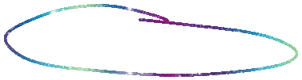
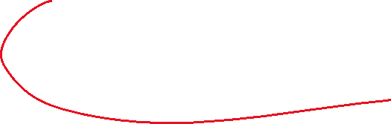


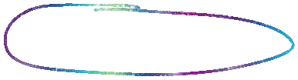


Slide 4
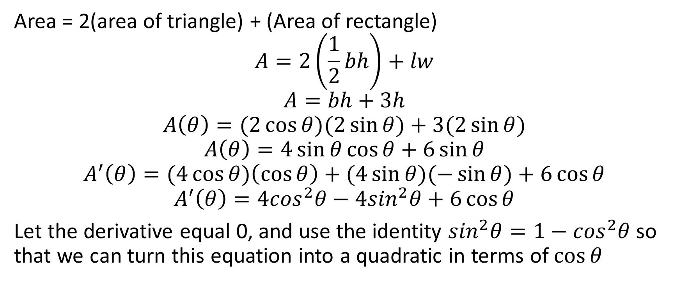
Area = 2(area of triangle) + (Area of rectangle)
$$A=2\left(\frac{1}{2}bh\right)+lw$$
$$A=bh+3h$$
$$A\left(θ\right)=(2\cos{θ)(2\sin{θ)+3(2\sin{θ)}}}$$
$$A\left(θ\right)=4\sin{θ\cos{θ+6\sin{θ}}}$$
$$A^{′}\left(θ\right)=(4\cos{θ)\left(\cos{θ}\right)+(4\sin{θ)(−\sin{θ)+6\cos{θ}}}}$$
$$A^{′}\left(θ\right)=4\cos^{2}θ−4\sin^{2}θ+6\cos{θ}$$
Let the derivative equal 0, and use the identity $\sin^{2}θ=1−\cos^{2}θ$ so that we can turn this equation into a quadratic in terms of $\cos{θ}$

Slide 5
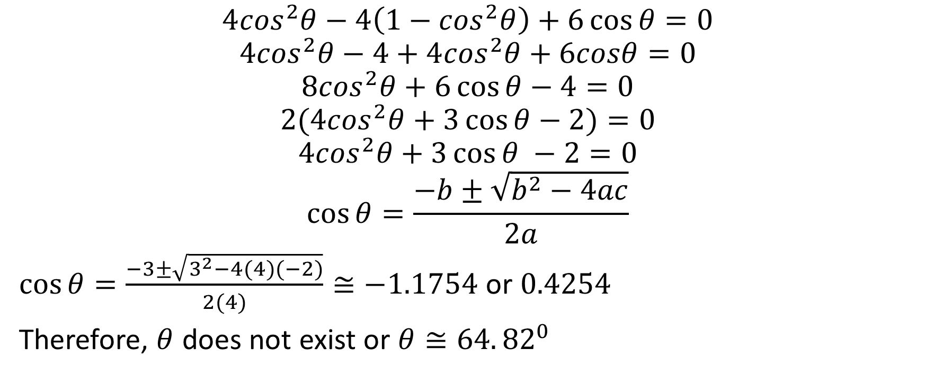
$$4\cos^{2}θ−4\left(1−\cos^{2}θ\right)+6\cos{θ=0}$$
$$4\cos^{2}θ−4+4\cos^{2}θ+6cosθ=0$$
$$8\cos^{2}θ+6\cos{θ}−4=0$$
$$2(4\cos^{2}θ+3\cos{θ−2)=0}$$
$$4\cos^{2}θ+3\cos{θ −2=0}$$
$$\cos{θ}=\frac{−b±\sqrt{b^{2}−4ac}}{2a}$$
$\cos{θ=\frac{−3±\sqrt{3^{2}−4(4)(−2)}}{2(4)}}≅−1.1754$ or $0.4254$
Therefore, $θ$ does not exist or $θ≅64.{82}^{0}$

Slide 6

$A\left(64.{82}^{0}\right)=4\sin\left(64.{82}^{0}\right)cos({64.{82}^{0})}+6\sin\left({64.82}^{0}\right)$ ≌ 6.97
Therefore the largest possible area of the trapezoid is approximately $6.97 m^{2}$

